Slide 1

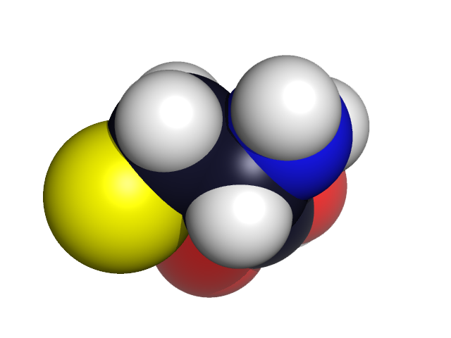
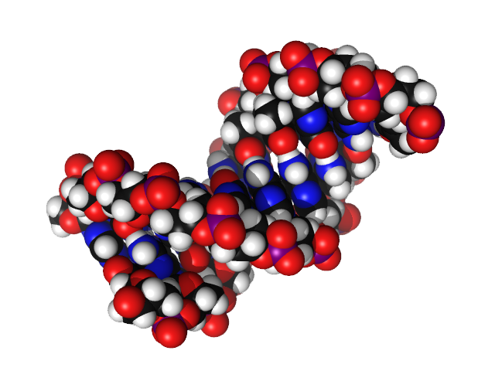
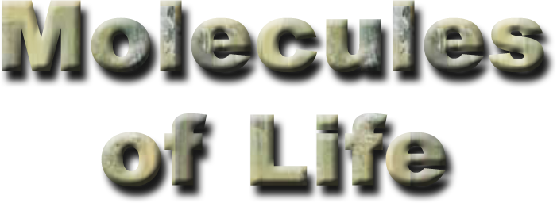
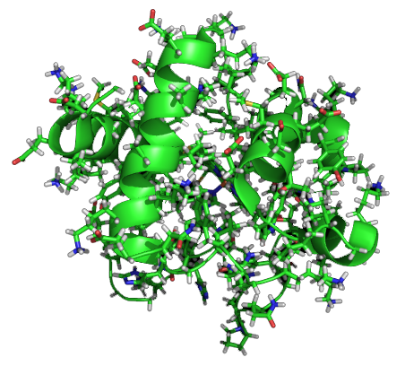
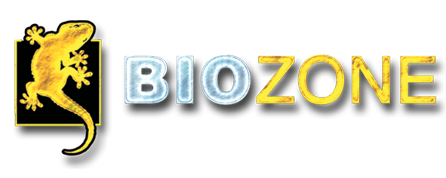
Cell Biology & Biochemistry Series:
Set 1
Version: 1.0

Slide 2
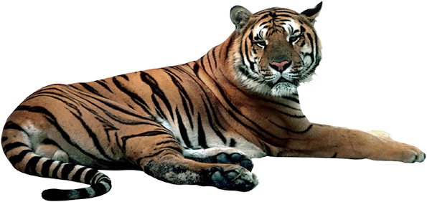
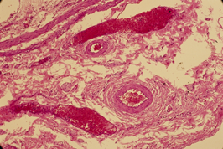
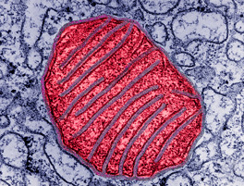
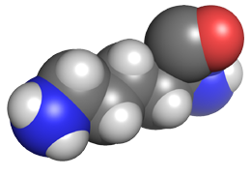
Introduction to Molecules
Organism
Tiger
Living things can be organized into several different levels or tiers of structure. The most basic of these is the molecular level.
Cellular level
Heart muscle cells
Organelle level
Mitochondrion
Molecular level
Amino acid -lysine

Slide 3


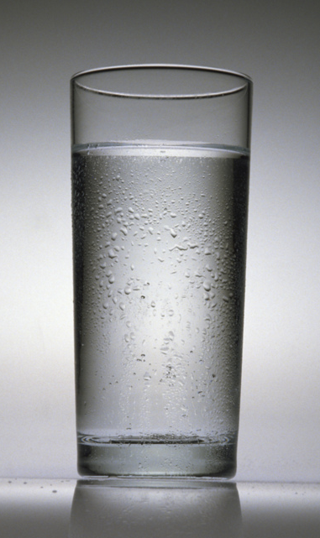
Biological Molecules
All objects are made up of millions of molecules too small to see with the naked eye.
For example, a glass of water contains millions of water molecules.
Water (H2O) molecules

Slide 4
Biological Molecules
Water is not always pure, and may contain other molecules.
When one or more substances are added together, a mixture is formed.
Na⁺
Cl–
Na⁺
Cl–
Na⁺
Cl–
Cl–
Na⁺
This mixture contains salt (NaCl) and water (H2O).

Slide 5

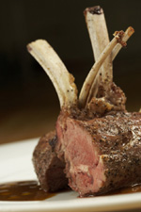
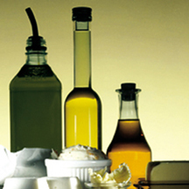
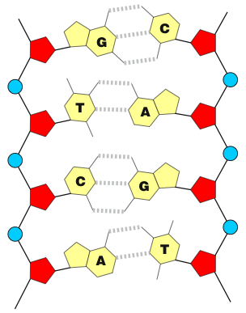
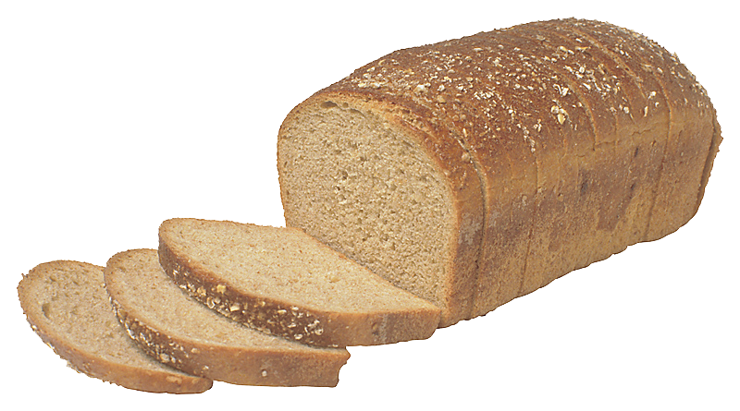
Types of Biological Molecules
The molecules that make up living things can be grouped into five classes:
Water
Proteins
Lipids
Nucleic acids
Carbohydrates

Slide 6
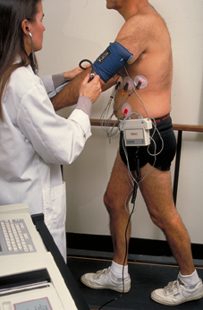
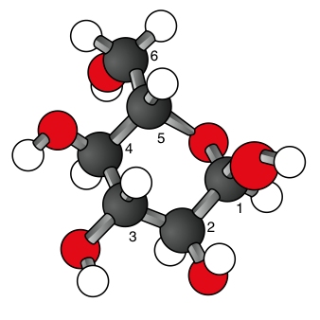
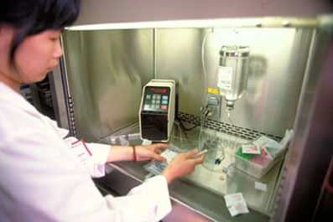
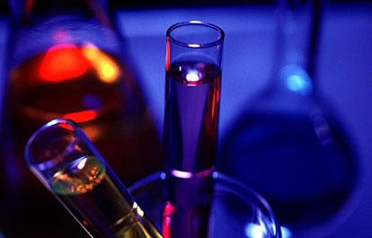
The Importance of Biological Molecules
An understanding of the structure and function of biological molecules is necessary in many branches of biology, especially biochemistry, physiology, and
molecular genetics.

Slide 7

Biological Formulae
Biological molecules can be portrayed by:
  molecular formula
  structural formula
Molecular Formula
The molecular formula expresses the number of atoms in a molecule, but does not convey its structure.
Molecular formula for the amino acid cysteine
Structural Formula
The structure of a molecule can be conveyed by a
molecular model.
This space filling model shows the structural formula for the
amino acid cysteine
C3H7O2S

Slide 8
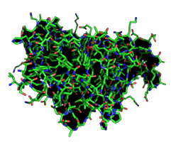
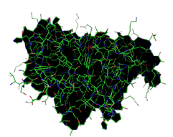
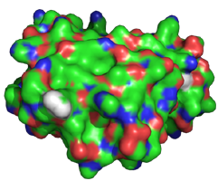
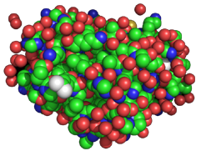
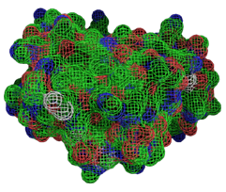
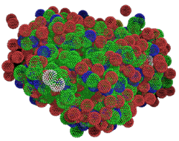
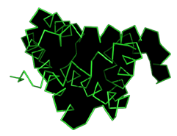
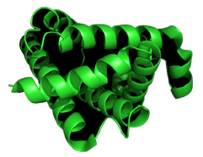
Illustrating the Structure of Molecules
Sticks
Lines
Spheres
Surface
Mesh
Dots
Ribbon
Cartoon
Notes:
The protein molecule being depicted is sperm whale myoglobin.

Slide 9
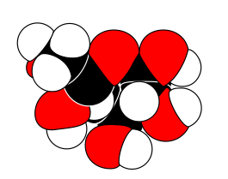
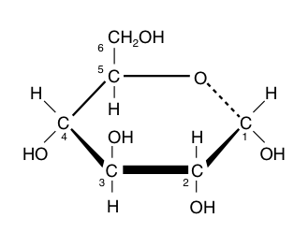
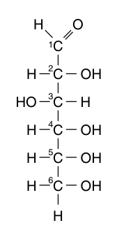
Biological Formulae
There are several ways of expressing a molecule’s structural formula. For example, glucose has the molecular formula C6H12O6.
  The structural formulae are:
Space filling model
β-D-glucose
Structural formula
α glucose (ring form)
Structural formula
(straight form)
Ball and stick model

Slide 10

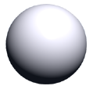
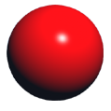
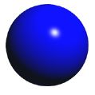
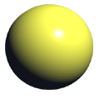
Important Biological Molecules
Carbon
Biological molecules that contain carbon are said to be organic compounds.
  Most cellular material is organic.
  In addition to carbon, organic molecules commonly include atoms of oxygen and hydrogen.
  Nitrogen and sulfur are components of organic molecules such as amino acids and nucleotides.
Compounds that do not contain carbon are said to be inorganic molecules.
Hydrogen
Oxygen
Nitrogen
Sulfur

Slide 11
Chemical Bonds
Chemical elements are able to form chemical bonds. These are linkages made between the atoms in molecules.
  Bonds act as a chemical glue to hold atoms together.
  Chemical bonds are formed when atoms share or transfer electrons.
Atom
Bond

Slide 12
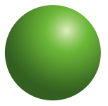
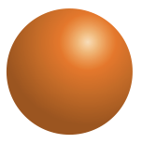
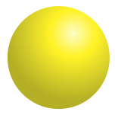
The Structure of an Atom
An understanding of an atom’s structure is required to understand how chemical bonds form.
An atom comprises a nucleus orbited by negatively charged electrons.
The nucleus is made up of:
  positively charged protons.
  neutrons, which have no charge.
Nucleus
Neutron
The diagram on the right depicts a sodium atom.
Its nucleus contains:
• 11 positively charged protons
• 12 neutrons (no charge).
Eleven negatively charged electrons orbit the nucleus in three electron shells.
Proton
Electron

Slide 13
Electron Shells
Electron
All atoms have electron shells.
Each shell contains electrons, which orbit around the nucleus.
  The number of shells and number of electrons vary with the type of atom.
The number of electrons in each shell can be calculated by:
2n² where n = the shell number
In general, atoms are most stable when they have eight electrons in their outermost shell.
  The outer shell is called the valency shell.
valency shell
Nucleus
A sodium (Na) atom has 11 electrons within three electron shells:
2 in the first shell
8 in the second shell
1 in the third shell

Slide 14
Chemical Bonds
Atoms tend to lose or gain electrons until they have a stable configuration.
This can be illustrated by the formation of sodium chloride.
  When sodium reacts with chloride, it releases the single electron in its valency shell to chloride.
  The sodium atom now has 10 electrons and the chloride atom now has 18 electrons.
  Both have eight electrons in their valency shells.
  The atoms now exists as ions, because they have each lost or gained an electron.
Na
Cl
Sodium and chloride atoms
Na⁺
Cl–
Ionic bond
The sodium and chloride atoms have taken on ionic forms, and have formed a chemical bond based on electrostatic attraction. The compound they form together is sodium chloride (NaCl).

Slide 15
Covalent Bonds
H
H
Covalent bonds form when electron pairs between two atoms are shared.
  The number of electrons required to complete an atom’s valency shell will determine how many bonds an atom will form.
  The bonds are directional and determine the strength of the bond.
  Non-metals tend to form covalent bonds readily.
  A line is used to depict the covalent bond (e.g. H-H).
H - H
Two hydrogen atoms (above) each have one electron in their valency shell. They share an electron so the valency shell has its full complement of two electrons. Only one covalent bond is possible
O
O
Two oxygen atoms (right) form an oxygen molecule by sharing two pairs of electrons. A double covalent bond (=) is formed.
O = O

Slide 16
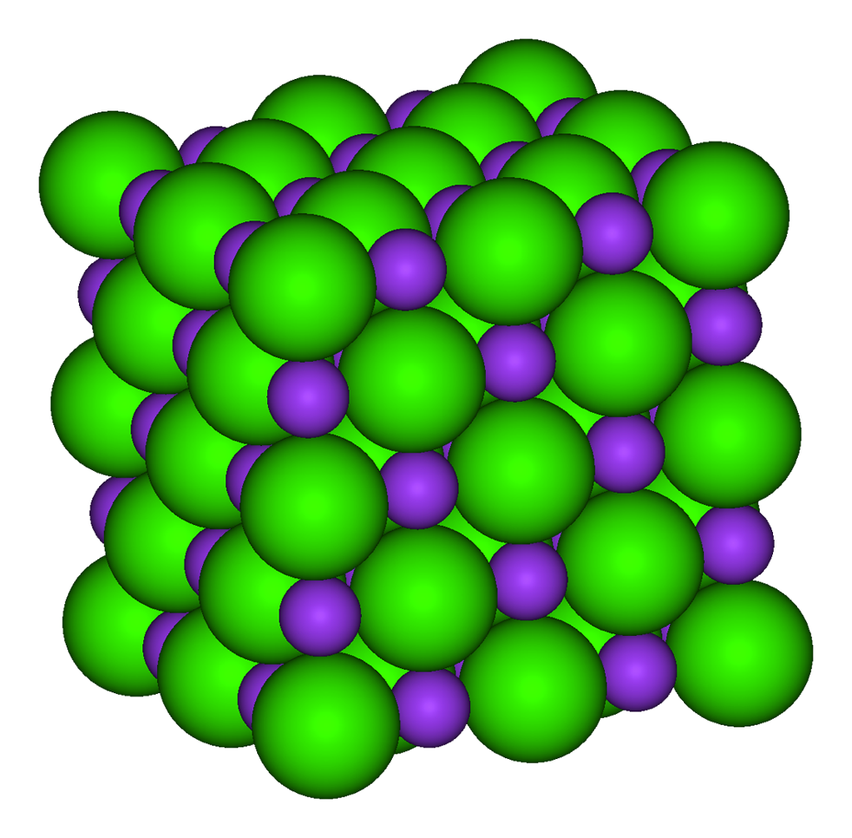
Ionic Bonds
Ionic bonds result from the electrostatic attraction between two atoms of opposite charge.
When electrons are transferred between atoms, the atoms become charged ions. These take two forms:
  Cation: an ion with a positive charge
  (has lost an electron).
  Anion: an ion with a negative charge
  (has gained an electron).
Na
Cl
Na⁺
Cl⁻
Ionic bond
A transfer of electrons leaves the sodium with a net charge of +1 and the chloride with a net charge of -1. The ions are attracted together because of their opposite charge, and a sodium chloride (NaCl) crystal is formed (left).

Slide 17
Hydrogen Bonds
Hydrogen bonds involve at least one hydrogen atom.
  A hydrogen atom covalently linked to
  an electronegative atom, is attracted
  to another electronegative atom (often
  oxygen or nitrogen atoms).
The formation of a water dimer* is an
example of hydrogen bonding.
  A water molecule (H2O) has a slight positive
  charge on the hydrogens and a slight negative
  charge on the oxygen.
  Electrical attraction between the negative
  charge of one molecule and the positive charge
  of another results in formation of a hydrogen bond.
Hydrogen bonding is also important in the
formation of proteins and nucleic acids (e.g. DNA).
-
O
H
H
Hydrogen bond
+
+
-
O
H
+
H
+
A water dimer forms by hydrogen bonding between the positive and negative charges of two water molecules.
*Dimer: a molecule composed of two identical subunits linked together

Slide 18
Disulfide Bonds
Protein chain
A disulfide bond (or sulfur bridge) is a single covalent bond between two sulfur containing atoms.
Disulfide bonds are important in the folding and stability of proteins.
  Disulfide bonds occur between cysteine, a sulphur containing amino acid.
H
H
C
SH
HS
C
H
H
Cysteine residues
H
H
C
S
S
C
H
H
Disulfide bond

Slide 19



Van der Waals Forces
Van der Waals forces are a very weak attraction
of molecules when they are very close.
  They occur between non-polar molecules or atoms.
  They are the weakest of all intermolecular forces; much weaker than chemical bonds.
  The constant motion of electrons around
  a molecule causes temporary partial
  charge; a temporary dipole moment.
  The dipole moment induces a temporary
  dipole in a neighboring atom by attracting
  or repelling its electron cloud.
The electron distribution changes
constantly so the attractions are brief
and very weak.
If many Van der Waals forces act at the same time, they can be significant (e.g. in protein configuration).
–
–
–
–
–
–
–
–
–
Electrons evenly spread around the nucleus
–
–
–
–
–
–
–
–
–
–
–
–
–
–
–
Temporary dipole moment
–
–
–
–
–
–
–
–
–
–
–
–
–
–
–
–
–
–
–
–
–
–
–
–
Attraction of temporary dipoles

Slide 20
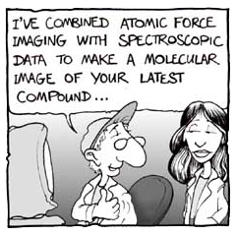
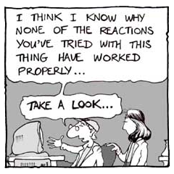
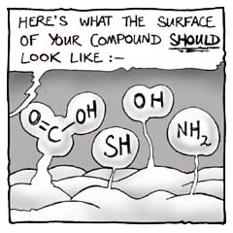
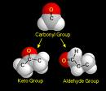
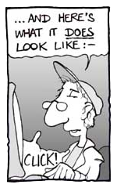
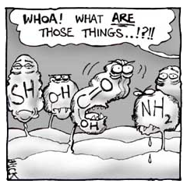
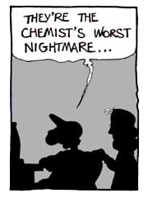
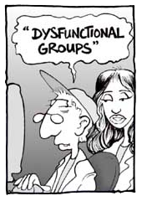
Functional Groups
Organic compounds usually comprise a carbon skeleton with reactive or functional groups attached.
Functional groups are often involved in chemical reactions, and play an important role in the structure and function of the molecule.
Cartoon courtesy of Nick Kim

Slide 21
Functional Groups
Functional groups have definite chemical properties that they retain not matter where they occur.
These functional groups determine the characteristics and chemical reactivity of molecules. For example:
  Amino groups make a molecule more basic.
  Carboxyl groups make a molecule more acidic.
Most chemical reactions that occur in organisms involve the transfer of a functional group as an intact unit from one molecule to another.
Common biological functional groups are shown in the table right:
Group | Structural Formula | Found in
Hydroxyl |  | Carbohydrates, alcohols
Carbonyl |  | Formaldehyde
Carboxyl |  | Amino acids, vinegar
Amino |  | Ammonia
Sulfhydryl |  | Proteins, rubber
Phosphate |  | Phospholipids, nucleic acids, ATP
OH
C
O
O
C
OH
H
N
H
S
H
O –
O
P
O –
O

Slide 22
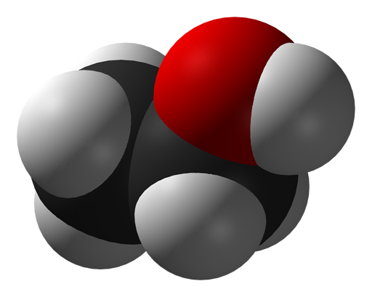
Hydroxyl Group -OH
H
H
Hydroxyl group
The hydroxyl group consists of an oxygen atom joined by a single covalent bond to a hydrogen atom.
Organic molecules containing hydroxyl groups are alcohols.
A metal hydroxide is formed when a hydroxyl group is joined to a metal (e.g. sodium hydroxide).
H
C
C
OH
H
H
Structural formula of ethanol, shown as a straight chain (top) and a space filling model (bottom).

Slide 23
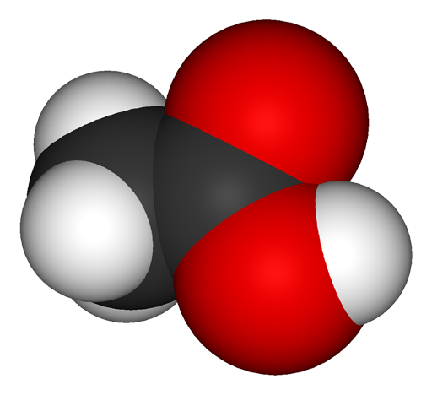
Carboxyl Group -COOH
H
O
The carboxyl functional group consists of a carbon atom joined by covalent bonds to two oxygen atoms, one of which in turn is covalently bonded to a hydrogen atom.
Organic molecules containing carboxyl groups are called carboxylic acids (organic acids).
One valence electron on the carbon is available for bonding to another atom so that the carboxyl group can form part of a larger molecule.
H
C
C
H
OH
In this acetic acid molecule, the carboxyl group is highlighted.

Slide 24
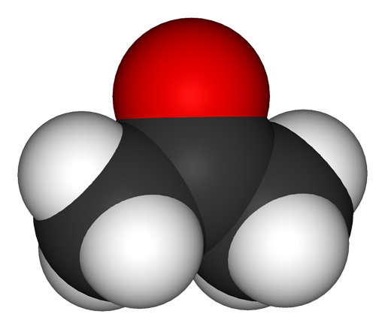
Carbonyl Group -CO
H
H
The carbonyl group is a functional group composed of a carbon atom joined to an oxygen atom by a double bond.
If the carbonyl group occurs at the end of a carbon molecule it is called an aldehyde.
If the carbonyl group occurs
within the carbon compound
it is called a ketone.
O
H
C
C
C
Propanal is an example of an aldehyde.
H
H
H
H
O
H
H
C
C
C
H
H
H
Acetone is an example of a ketone.

Slide 25
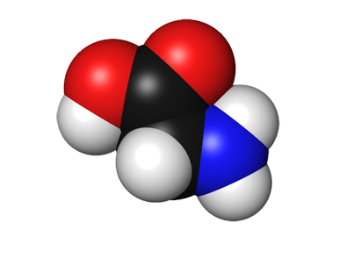
Amino Group -NH2
H
H
A amino group consists of one nitrogen atom attached by covalent bonds to two atoms of hydrogen. A lone valence electron on the nitrogen is available for bonding to another atom.
Organic molecules containing amino groups are called amines.
Amines are weak bases.
The amino group is common to all amino acids, which in turn are the building blocks of proteins.
O
C
C
N
Amino group
HO
H
H
Glycine (above, and space filling model below) is the simplest amino acid

Slide 26
Phosphate Group -PO3
A phosphate group composed of one phosphorous atom bound to four oxygen atoms.
Organic molecules containing phosphate groups are called organic phosphates.
The phosphate group is one of the three components of nucleotides and often attached to proteins and other biological molecules.
A free phosphate ion in solution and is called inorganic phosphate (denoted Pi) to distinguish it from phosphates bound in molecules.
OH
OH
H
O
H
C
C
C
O
P
O–
H
H
H
O–
The phosphate group of this glycerol phosphate molecule
is shown in red.

Slide 27

Sulfhydryl Group -SH
H
H
A sulfhydryl group consists of a sulfur atom bonded to a hydrogen atom.
Organic molecules containing sulfhydryl groups are called thiols.
As the functional group of the amino acid cysteine, the thiol group plays an important role in biological systems.
  Disulfide bonds between adjacent cysteine residues are important for
  protein folding and structure.
  In proteins, disulfide bonds contribute to:
    tertiary structure if the cysteines are part of the same peptide chain
    quaternary structure, by forming covalent bonds between different peptide chains.
OH
HS
C
C
C
H
NH2
O
The sulfhydryl group in the amino acid cysteine is shown here in red.
Sulfur atom
Cysteine (above) is one of two amino acids which contain a sulfur group. The other is methionine.

Slide 28
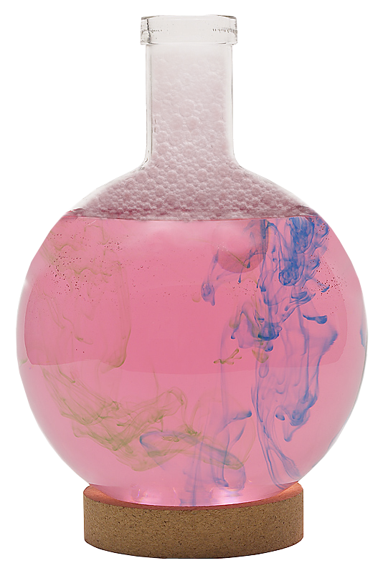

Water
Water provides an environment in which metabolic reactions can take place.
Water participates in, and is a common product of, many reactions.

Slide 29

The Water Molecule
The most important feature of the chemical behavior
of water is its dipole nature.
Dipole means having two charges.
  There is a small positive charge on each of the two hydrogens.
  There is a small negative charge on the oxygen.
–
Small negative charge
O
H
H
A water molecule has the molecular formula H2O
+
+
Small positive charge

Slide 30
Biologically Important Properties of Water
Property of Water | Significance for life
Ice is less dense than water | Ice floats and also insulates the underlying water
High surface tension | Water forms droplets on surfaces and runs off
Low viscosity | Water flows through very small spaces and capillaries
Liquid at room temperature | Liquid medium for aquatic life and inside cells
Colorless with a high transmission of visible light | Light penetrates tissue and aquatic environments
Strong cohesive properties and high tensile strength | Water can be lifted and does not pull apart easily
Many substances can dissolve in water (it is classified as a universal solvent) | Medium for the chemical reactions of life (metabolism). Water is the main transport medium in organisms.

Slide 31
Biologically Important Properties of Water
Property of Water | Significance for life
Water has a high latent heat of fusion; significant amounts of energy are required before water will change state. | Cell contents are unlikely to freeze.
Water has a high latent heat of vaporization; in order to evaporate, water must absorb a large amount of energy. | Heat is lost by evaporation of water. Sweating in animals and transpiration in plants cause rapid cooling.
Water has a high specific heat capacity; it can absorb a lot of energy for only a small rise in temperature. | Aquatic environments are thermally stable. Organisms can maintain stable internal temperatures despite fluctuations in external temperature.

Slide 32

pH
Two water molecules
Water has a tendency to transfer
electrons to another water molecule.
  One water molecule becomes positively charged because it gains a proton (H⁺) to become a hydronium ion (H3O⁺).
  The other becomes negatively charged because it loses a proton to form a
  hydroxide ion (OH–).
  H2O + H2O ⇌ H3O⁺ + OH–
This reaction is often simplified by thinking of the process as a dissociation where:
H2O ⇌ H⁺ + OH–
+
–
A hydronium ion (H3O⁺) has a positive charge (+1)
A hydroxide ion (OH⁻) has a negative charge (-1).

Slide 33

pH
The levels of hydrogen ions (H⁺) in solution can be measured using the pH scale.
pH is the negative logarithm of the hydrogen ion concentration expressed in moles per liter.
A pH meter measures the pH of a solution.
  It consists of electrodes which contain a probe.
  The probe measures the voltage of the solution
  and converts it into pH units.
  An electronic meter displays the pH reading.
pH = -log [H⁺]
Photo: Pasco
The pH meter above consists of a probe attached to a hand held display unit.

Slide 34


Acids and Bases
In pure water the concentration of H⁺ and OH⁻ are equal. One water molecule yields one H⁺ ion and one OH⁻ ion.
  The solution is said to be neutral.
When other substances are added to water, the balance of H⁺ and OH⁻ is altered. The solution can be:
  Acidic: has a higher concentration of H⁺ than OH⁻.
  Basic (alkaline or caustic): has a higher concentration of OH⁻ than H⁺.

Slide 35







The pH Scale
Lemon juice
Battery acid
0
1
The pH scale:
  measures the concentration of hydrogen ions (H⁺) in a solution.
  is a logarithmic scale of measurement.
  has a scale range from 0 to 14.
On the pH scale:
  7 is neutral (H⁺ = OH⁻).
  0 - 6.9 is acidic (H⁺ > OH⁻).
  7.1 - 14 is basic (H⁺ < OH⁻).
2
3
4
Tomatoes
Milk
5
6
7
Blood
8
9
10
11
12
13
Sodium hydroxide solution
Ammonia-based cleaning fluids
14

Slide 36




Acids
Other substances may contribute to the concentration of H⁺ or OH⁻ in a solution.
An acid is a substance that increases the H⁺ concentration by dissolving into
H⁺ and its anion.
  An acid is a proton donor.
  The dissolution of an acid substance into a solution releases H⁺ which lowers the pH.
HCl → H⁺ + Cl⁻
Examples of
acidic substances
Lemon juice = pH 2
Tomatoes = pH 4
Black coffee = pH 5
The hydrogen ion contributes to the acidity of a solution.
The chloride ion is
an anion (a negatively charged ion)

Slide 37


Bases
A base is a substance that reduces
the H⁺ concentration in solution.
A base is a proton acceptor.
A base can lower the hydrogen ion concentration of a solution in two ways:
  Directly: By formation of a hydroxide ion (OH⁻), which can bind a H⁺ ion to form H2O, as with sodium hydroxide (NaOH).
NaOH → Na⁺ + OH⁻
OH⁻ + H⁺ ⇌ H2O
  Indirectly: The base accepts a H⁺ from water. The base is ionized and an OH⁻ is released, as occurs with ammonia (NH3).
  NH3 + H2O ⇌ NH4⁻ + OH⁻
NaOH
Limestone
Examples of basic substances
1M sodium hydroxide = pH 14
Limestone (calcium carbonate) = pH 12

Slide 38

Biological pH
Most biological fluids have a pH close to neutral (e.g. blood is 7.4, urine range 6.5 -8.0).
  Stomach acid is an exception at pH 1.5. In this case, mucus secretions protect the stomach lining from damage.
In biological systems, the pH of biological fluids is critical for proper function.
  Small changes (increasing acidity or alkalinity) can be damaging to the body and may result in death.
The pH of biological fluids is maintained by the presence of buffers.
  Buffers, such as blood proteins, minimize pH changes by accepting H⁺ ions when there is an excess, and donating H⁺ ions when there is a shortage.
Metabolic reactions, e.g. during exercise, can alter blood chemistry. A drop in blood pH below 7.0 (acidosis) or a rise above 7.8 (alkalosis) for more than a few minutes can be fatal. Blood buffers normally prevent this, but some physiological problems, such as starvation, excessive vomiting, or renal failure, can result in death because of disturbances to blood pH.

Slide 39


Inorganic Ions
Inorganic ions are important for the structure and metabolism of all living organisms.
An ion is an atom (or group of atoms) that has gained or lost one or more electrons. Many of these ions are water soluble.
Oxygen is attracted to the Na⁺
Hydrogen is attracted to the Cl⁻
Water surrounding a negative chloride ion (Cl⁻).
Water surrounding a positive sodium ion (Na⁺).

Slide 40



Inorganic Ions
Ion | Name | Biological role
Ca²⁺ | Calcium | Component of bone and teeth
Mg²⁺ | Magnesium | Component of chlorophyll
Fe²⁺ | Iron (II) | Component of hemoglobin
NO3⁻ | Nitrate | Component of amino acids
PO4³⁻ | Phosphate | Component of nucleotides
Na⁺ | Sodium | Involved in the transmission of nerve impulses in neurons
K⁺ | Potassium | Involved in controlling plant water balance
Cl⁻ | Chloride | Involved in the removal of water from urine
Bone
Neuron
Hemoglobin showing iron containing heme group in green

Slide 41


Carbohydrates
Carbohydrates are a family of organic molecules made up of carbon, hydrogen, and oxygen atoms. Some are small, simple molecules, while others form long polymers.
Carbohydrates have the general formula (CH2O)x.
Simple carbohydrates are generally
called sugars.The most common
arrangements found in sugars are:
  Pentose, a five sided sugar,
  e.g. ribose and deoxyribose.
  Hexose, a six sided sugar,
  e.g. glucose and fructose.
  A structural formula and
  symbolic form are shown.
  In solution, these naturally form rings rather than straight chain structures.
Deoxyribose
6
Glucose
1
4

Slide 42





Carbohydrates
Carbohydrates are important as both energy storage molecules and as the structural elements in cells and tissues.
The structure of carbohydrates is closely related to their functional properties.
  Sugars (mono-, di-, and trisaccharides)
  play a central role in energy storage.
  Carbohydrates are the major component
  of most plants (60-90% of dry weight).
Carbohydrates are used by humans:
as a cheap food source
as a source of fuel
for housing and clothing
Weaving cloth
Carbohydrates are used by humans as a cheap food source...
Collecting thatch for roofing
Carrying wood
...housing and clothing. Cotton, linen, and coir are all made up of cellulose, a carbohydrate polymer.
...and as a source of fuel,...

Slide 43

Monosaccharides
Monosaccharides are used as a primary energy source for fueling cellular metabolism.
Monosaccharides are single-sugar molecules. They include:
  glucose (grape sugar and blood sugar).
  fructose (honey and fruit juices).
Monosaccharides generally contain
between three and seven carbon atoms in their carbon chains.
  The 6C hexose sugars occur
  most frequently.
All monosaccharides are reducing
sugars, meaning they can participate in reduction reactions.
Glucose is a monosaccharide sugar. It occurs in two forms, the L- and D- forms. The D-glucose molecule (above) can be utilized by cells while the L-form cannot.

Slide 44

Disaccharides
Disaccharides are double-sugar molecules joined with a glycosidic bond.
They are used as energy sources and as building blocks for larger molecules.
Disaccharides provide a convenient way to transport glucose.
The type of disaccharide formed depends on the monomers (single units)involved and whether they are in their α- or β- form.
Only a few disaccharides (e.g. lactose) are classified as reducing sugars.

Slide 45


Carbohydrate Isomers
α-glucose
Compounds with the same chemical formula can have different arrangement of atoms. These molecules are called isomers.
Structural isomers have the atoms linked in a different sequence from one another.
  Despite the relatively small differences, structural isomerism can have important consequences for the polymers that result. For example:
    α glucose polymers form starch.
    β glucose polymers form cellulose.
    These molecules have very different properties.
Optical isomers are identical in every way but are mirror images of each other.
β-glucose
The α and β glucose molecules, (above), are examples of structural isomers. They contain the same atoms but the hydroxyl groups are linked to the C1 atom differently.

Slide 46


Disaccharides
Sucrose
  Components: α-glucose + β-fructose
  Source: A simple sugar found in plant sap.
Maltose
  Components: α-glucose + α-glucose
  Source: Maltose is a product
  of starch hydrolysis and is
  found in germinating grains.
Lactose
  Components: β-glucose + β-galactose
  Source: Milk
Cellobiose
  Components: β-glucose + β-glucose
  Source: Partial hydrolysis of cellulose.
Juniper sap
A sucrose molecule (above) depicted as a stick molecule.
Milk (right) contains the disaccharide, lactose.

Slide 47

Polysaccharides - Cellulose
Symbolic form of cellulose
Cellulose is a glucose polymer. It is an important structural material found in plants.
It is made up of many unbranched
chains of β-glucose molecules
held together by 1, 4 glycosidic links.
Parallel chains are cross-linked by hydrogen bonds to form bundles called microfibrils.
  Cellulose microfibrils are very strong.
  They form a major structural component
  of plant cells, e.g. in the cell wall.
Glucose monomer
1
4
1,4 glycosidic bonds create unbranched chains
The cellulose structure is shown (right) as a ball and stick model. Cellulose is repeating chains of β-glucose molecules.

Slide 48

Polysaccharides - Starch
Starch is a polymer of glucose, made up of long chains of α-glucose molecules.
Starch contains a mixture of:
  25-30% amylose: long unbranched chains of many hundreds of glucose linked by 1-4 glycosidic bonds.
  70-75% amylopectin: branched chains with 1-6 glycosidic bonds every 23-30 glucose units.
Starch is an energy storage molecule in plants.
  It is found concentrated in insoluble starch granules within plant cells.
Starch can be easily hydrolyzed to glucose when required.
Symbolic form of amylopectin
1,6 glycosidic bonds create branched chains
1
1
4
6
1
4
6
1
4
Starch granules
Photo: Brian Finerran

Slide 49


Polysaccharides - Glycogen
Glycogen is chemically similar to amylopectin, but is more extensively branched.
It is composed of α-glucose molecules, but there are more
1,6 glycosidic links mixed with the 1,4 glycosidic links.
Glycogen is the energy storage compound in animal tissues and in many fungi.
It is more water soluble than starch and is found mainly in liver and muscle cells, which are both centers of high metabolic activity.
Glycogen is readily hydrolyzed by enzymes to release glucose.
1,6 bonds
Symbolic form of glycogen
Glycogen is abundant in metabolically active tissues such as liver (left) and skeletal muscle (right). The glycogen stains dark magenta.

Slide 50

Modified Polysaccharides
6
Nitrogen containing group on each glucose
NHCOCH3
6
NHCOCH3
O
O
O
O
5
3
2
5
3
2
4
1
4
1
4
1
4
1
3
2
5
O
3
2
5
O
O
NHCOCH3
6
NHCOCH3
6
Chitin is a tough modified polysaccharide made up of chains of β-glucose molecules.
Structurally, it is almost the same as cellulose except that the -OH group at carbon atom 2 is replaced by a nitrogen-containing group (NH.CO.CH3).
Chitin forms bundles of long parallel chains.
It is found in the cell walls of fungi and it is an essential component of the arthropod exoskeleton.
The exoskeleton of an insect is made of chitin

Slide 51
Condensation & Hydrolysis
Monosaccharides are joined together to form disaccharides and polysaccharides.
Water is released in the process.
Energy is supplied by a nucleotide sugar such as ADP-glucose.
Compound sugars can be broken down into their constituent monosaccharides.
A water molecule provides the hydrogen and hydroxyl groups required.
The reaction is catalyzed by enzymes.
Carbohydrate condensation
Carbohydrate hydrolysis
hydrolysis
condensation
O

Slide 52
Condensation & Hydrolysis
2 monosaccharides
Condensation reaction
Hydrolysis reaction
H2O
Disaccharide + H2O
O
Glycosidic bond

Slide 53

Condensation & Hydrolysis
2 α-glucose
molecules
Condensation
Hydrolysis
H2O
Maltose
molecule
Glycosidic bond

Slide 54
Lipids
Lipids are a group of organic compounds with an oily, greasy, or waxy consistency.
Like carbohydrates, lipids contain carbon, hydrogen, and oxygen, but in lipids, the proportion of oxygen is much smaller.
They are relatively insoluble in water and tend to be hydrophobic (water repellent).
Lipids are soluble in organic solvents such as ethanol and ether.
Typical lipids, e.g. neutral fats, consist of fatty acids and glycerol (below).
H
O
H
C
OH
OH
C
CH2 CH2 CH2 CH2 CH2 CH2 CH2 CH2 CH2 CH2 CH2 CH2 CH2 CH2 CH2 CH2 CH2
O
H
C
OH
OH
C
CH2 CH2 CH2 CH2 CH2 CH2 CH2 CH2 CH2 CH2 CH2 CH2 CH2 CH2 CH2 CH2 CH2
O
H
C
OH
OH
C
CH2 CH2 CH2 CH2 CH2 CH2 CH2 CH2 CH2 CH2 CH2 CH2 CH2 CH2 CH2 CH2 CH2
H
Glycerol
Three fatty acids

Slide 55


Lipids
Lipids can be classified as:
  simple lipids: fats, oils, and waxes.
  phospholipids and related molecules.
  steroids
Lipids have many roles, including as:
  biological fuels
  hormones
  structural components of membranes
Fats provide twice as much energy as carbohydrates.
Fats and oils are not macromolecules but, because of their hydrophobic properties, they aggregate into globules.
Proteins and carbohydrates can be converted into fats stored in adipose tissue.
Plasma membrane
Phospholipids are the primary structural component of all cellular membranes, such as the plasma membrane (false color TEM above).
Fat cell
Capillary
Dept. Biological Sciences, University of Delaware
Lipids are often stored in special adipose tissue, within large fat cells (above).

Slide 56




Biological Roles of Lipids
Mitochondrion (false color TEM)
Lipids are concentrated sources of energy and can be broken down (through fatty acid oxidation in the mitochondria) to provide fuel for aerobic respiration
Waxes and oils, when secreted on to surfaces provide waterproofing in plants and animals.
Phospholipids form the structural framework of cellular membranes, e.g. the plasma membrane (above).
Fat absorbs shocks. Organs that are prone to bumps and shocks (e.g. kidneys) are cushioned with a relatively thick layer of fat.

Slide 57




Biological Roles of Lipids
The white fat tissue (arrows) is visible in this ox kidney
Fat absorbs shocks. Organs that are prone to bumps and shocks (e.g. kidneys) are cushioned with a relatively thick layer of fat.
Lipids are a source of metabolic water. During respiration, stored lipids are metabolized for energy, producing water and carbon dioxide.
Stored lipids provide insulation in extreme environments. Increased body fat levels in winter reduce heat losses to the environment.

Slide 58

Fats and Oils
The most common lipids in living things are the neutral fats. They make up the fats and oils found in plants and animals.
Fats and oils are formed by condensation reactions between fatty acids and glycerol to form ester links (–COO–).
  One fatty acid = monoglyceride
  Two fatty acids = diglyceride
  Three fatty acids = triglyceride or triacylglycerol.
  Triacylglycerols are the most common of these.
Globules of fat or oil are compact and relatively inert
Water is lost to form an ester bond
H
O
H
C
OH
OH
C
CH2 CH2 CH2 CH2 CH2 CH2 CH2 CH2 CH2 CH2 CH2 CH2 CH2 CH2 CH2 CH2 CH2
O
H
C
OH
OH
C
CH2 CH2 CH2 CH2 CH2 CH2 CH2 CH2 CH2 CH2 CH2 CH2 CH2 CH2 CH2 CH2 CH2
O
H
C
OH
OH
C
CH2 CH2 CH2 CH2 CH2 CH2 CH2 CH2 CH2 CH2 CH2 CH2 CH2 CH2 CH2 CH2 CH2
H
Glycerol
Three fatty acids

Slide 59




Fats and Oils
The difference between fats and oils
is their physical state at 20°C.
  Fats are solid at 20°C.
  Oils are liquid at 20°C
These differences in the physical properties of fats and oils are a result of the type of fatty acid attached to the glycerol molecule.
The fatty acids making up triacylglycerols are long unbranched hydrocarbon chains (CH3(CH2)n –), ending with a carboxylic acid (–COOH).
  Some are saturated fatty acids, with a maximum number of hydrogen atoms.
  Some are unsaturated, with double bonds and fewer hydrogen atoms.
Oils are liquid at room temperature, while fats are solid
Palmitic acid: a saturated fatty acid
Linoleic acid: a saturated fatty acid

Slide 60
Saturated Fatty Acids
Saturated fatty acids contain the maximum number of hydrogen atoms. They do not contain any double bonds or other functional groups along the chain.
Saturated fatty acids form straight chains.
Lipids containing a high proportion of saturated fatty acids tend to be solids at room temperature, i.e. fats, such as butter and lard.
O
H
H
H
H
H
H
H
H
H
H
H
H
H
H
H
C
C
C
C
C
C
C
C
C
C
C
C
C
C
C
C
H
H
H
H
H
H
H
H
H
H
H
H
H
H
H
H
Palmitic acid is a saturated fatty acid. All of the spaces on the carbon bonds are filled by hydrogens, which results in a straight chain molecule, as shown in the space filling model (right).

Slide 61
Unsaturated Fatty Acids
Unsaturated fatty acids contain some carbon atoms that are double-bonded with each other (all of the spaces are not taken by hydrogen atoms).
Lipids with a high proportion of unsaturated fatty acids are oils and tend to be liquid at room temperature.
  The unsaturated nature causes kinks in the straight chains. When aligned in a lipid molecule, the kinked fatty acids do not pack in closely together; hence the more fluid structure of oils.
O
H
H
H
H
H
H
H
H
H
H
H
H
H
H
H
H
H
H
C
C
C
C
C
C
C
C
C
C
C
C
C
C
C
C
C
C
C
H
H
H
H
H
H
H
H
H
H
H
H
H
H
H
Linoleic acid is an unsaturated fatty acid. The double bonds between the carbon atoms prevent bonds to hydrogen. The double bonds produce a kink in the chain as shown on the space filling model (right).
Kink

Slide 62
Phospholipids
If one of the fatty acid groups of a triacylglyerol is replaced by a phosphate group, the the molecule is known as a phospholipid. A phospholipid consists of:
  a glycerol molecule
  two fatty acid chains
  a phosphate (PO4³⁻) group (ionised under the conditions in cells)
H2C
Nonpolar, hydrocarbon tails of two fatty acids condensed with glycerol
COO
HC
COO
O–
H2C
O
P
O–
O
Fatty acid
Glycerol
Fatty acid
Phosphate group from phosphoric acid (HPO4) condenses with the third -OH of glycerol
Symbolic representation of a phospholipid
PO4³⁻

Slide 63
Phospholipids
The phosphate end of the molecule is polar and attracted to water (hydrophilic) while the fatty acid end is non-polar and is repelled (hydrophobic).
As a result, phospholipids naturally form a bilayer with the
hydrophobic ends orientated inwards.
The phospholipid bilayer forms the main component of cellular membranes.
Glycerol and phosphate ‘head’: the hydrophilic part of the molecule
Hydrocarbon tail: hydrophobic part of the molecule.

Slide 64

Steroids
The basic structure of a steroid(shown symbolically above) is three six carbon atom rings, and one five carbon atom ring.
Steroids are classified as lipids, but their structure is quite different from that of other lipids.
The basic structure of a steroids is:
  three 6 carbon atom rings
  one 5 carbon atom ring.
Examples of steroids include:
  sex hormones (testosterone and estrogen)
  hormones such as cortisol and aldosterone
  cholesterol is a sterol lipid and is a precursor to several steroid hormones.
Steroid sex hormones are responsible for both primary and secondary sexual characteristics in males and females.

Slide 65
Lipid Condensation
Water is lost to form an ester bond
Triacylglycerols (also called triglycerides) form when glycerol bonds with three fatty acids.
Glycerol is an alcohol containing three carbons.
  Each carbon is bonded to a hydroxyl (–OH) group.
When glycerol bonds with the fatty acid, an ester bond is formed and water is released.
Three separate condensation reactions are involved in producing a triglyceride.
H
O
H
C
O
H
OH
C
CH2 CH2 CH2.............CH3
O
H
C
O
H
+
OH
C
CH2 CH2 CH2.............CH3
O
H
C
O
H
OH
C
CH2 CH2 CH2.............CH3
H
Glycerol
Three fatty acids
H
O
H
+
H2O
C
O
C
CH2 CH2 CH2.............CH3
O
H
C
O
C
CH2 CH2 CH2.............CH3
+
H2O
O
H
CH2 CH2 CH2.............CH3
C
O
C
+
H2O
H
Triacylglycerol (triglyceride)
Water

Slide 66
Introduction to
Nucleic Acids
Nucleic acids are biochemical macromolecules involved with the transmission of inherited information.
There are two main types of nucleic acids involved with inheritance:
  Deoxyribonucleic acid (DNA)
  Ribonucleic acid (RNA)
Nucleic acids are polymers
made up of many units
called nucleotides.
DNA (space filling model right) is the most commonly occurring nucleic acid.

Slide 67


Nucleotides
A nucleotide is the basic unit of a nucleic acid.
A nucleotide has three components:
  A phosphate group
  A sugar (two types are possible)
  A base (four types are possible)
Base
Phosphate
Base
Phosphate
Sugar
Sugar
Symbolic form of a nucleotide
Chemical structure of a nucleotide

Slide 68










Nucleotide Bases
There are five nucleotide bases found in nucleic acids.
The DNA nucleotide bases are:
  Adenine
  Guanine
  Cytosine
  Thymine
In RNA, the thymine nucleotide base is replaced with uracil. The other three nucleotides remain unchanged.
Purines |  |  | Adenine
• Double-ringed structures
 |  |  | Guanine
• Always pair up with pyrimidines
Pyrimidines |  |  | Cytosine
• Single-ringed structures
 |  |  | Thymine
• Always pair up with purines
 |  |  | Uracil
Base component of a nucleotide

Slide 69





Molecular Structure of Nucleotides
Sugar
base (adenine)
Guanine nucleotide
DNA and RNA
Adenine nucleotide
DNA and RNA
phosphate
Uracil nucleotide
RNA only
Cytosine nucleotide
DNA and RNA
Thymine nucleotide
DNA only

Slide 70



Formation of a Nucleotide
A nucleotide is formed when phosphoric acid and a base are chemically bonded to a sugar molecule.
Water is given off when both the phosphate group and base group are joined.
  Because water is given off, both reactions are condensation reactions.
H2O
H2O
(–H2O)
Condensation
Phosphoric acid
Hydrolysis
(+ H2O)
Part of a base
Sugar (deoxyribose)
Nucleotide of DNA

Slide 71
Formation of a Dinucleotide
Dinucleotides are formed when two nucleotides are covalently linked together by a condensation reaction.
The linkage occurs between the phosphate group of one nucleotide and the sugar of another.
The linkage is termed a phosphodiester linkage (or bond).
H2O
O
O
P
OH
O
Phosphodiester bond

Slide 72




Nucleic Acids
When a large number of nucleotides link together a nucleic acid (or polynucleotide) is formed.
Deoxyribonucleic acid (DNA) consists of two polynucleotide chains wrapped around each other in a spiral to form a double helix. DNA is found in:
  The chromosomes in the nucleus of eukaryotes
  The chromosomes and plasmids of prokaryotes
  Mitochondria
  Chloroplasts of plant cells
Ribonucleic acid (RNA) consists of a single strand of polynucleotide. RNA is found as:
  Transfer RNA (tRNA)
  Messenger RNA (mRNA)
  Ribosomal RNA (rRNA)
  As the genetic material of some viruses
Bacterial plasmid
Nucleus
DNA double helix
Chloroplast

Slide 73

DNA & RNA Compared
Structural differences between DNA and RNA are summarized below:
 | DNA | RNA
Strands | Double | Single
Sugar | Deoxyribose | Ribose
Bases | Guanine | Guanine
 | Cytosine | Cytosine
 | Thymine | Uracil
 | Adenine | Adenine
Double stranded
DNA molecule
Single stranded
RNA molecule

Slide 74

The DNA Molecule
Symbolic representation
Space-filling model
Purines join with pyrimidines in the DNA molecule by way of relatively weak hydrogen bonds with the bases forming cross-linkages.
This leads to the formation of a double-stranded molecule of two opposing chains of nucleotides:
  The symbolic diagram shows DNA as a flat structure.
  The space-filling model shows how, in reality, the DNA molecule twists into a double helix.
Hydrogen bonds

Slide 75


DNA Structure
Phosphates link neighboring nucleotides together to form one half of a double-stranded DNA molecule:
Purine base
(guanine)
Pyrimidine base
(cytosine)
Sugar (deoxyribose)
Phosphate
Hydrogen bonds
Pyrimidine base
(thymine)
Purine base
(adenine)

Slide 76


Amino Acids
Amino acids (such as proline below) are the basic units from which proteins are made.
Plants can manufacture all the amino acids they require, but animals must obtain a certain number of ready-made essential amino acids from their diet.
All other amino acids can be constructed from these essential amino acids.
The order in which the different amino acids are linked together to form proteins is controlled by genes on the chromosomes.
Tyr
Ser
Glu
Iso
Amino acids link together (right) to form proteins.
Phe
Met
Ala
Ala
Ser

Slide 77
Amino Acids
There are approximately 20 different amino acids acids found in proteins.
All amino acids have a common structure:
  The ‘R’ group is variable, which means that it is different in each
  amino acid.
The “R” group varies in chemical make-up with each type of amino acid
R
Carbon atom
NH2
C
COOH
H
Amine group
Carboxyl group makes the molecule behave like a weak acid
Hydrogen atom

Slide 78
Amino Acids
The ‘R’ groups of amino acids can have quite diverse chemical properties.
This “R” group gives the amino acid alkaline properties.
This “R” group can form disulfide bridges with other cysteines to create cross linkages in a polypeptide chain.
This “R” group gives the amino acid acidic properties.
NH2
CH2
CH2
CH2
CH2
SH
CH2
COOH
CH2
NH2
C
COOH
NH2
C
COOH
NH2
C
COOH
H
H
H
Cysteine
Lysine
Aspartic acid

Slide 79
Amino Acids
Not all amino acids can be manufactured by our body.
Ten must be obtained from our diet. These are called essential amino acids.
  The essential amino acids are marked by ◆
Amino acids occurring in proteins
Alanine | Glycine | Proline
Arginine | ◆Histidine | Serine
Asparagine | ◆Isoleucine | ◆Threonine
Aspartic acid | ◆Leucine | ◆Tryptophan
Cysteine | ◆Lysine | ◆Tyrosine
Glutamine | ◆Methionine | ◆Valine
Glutamic acid | ◆Phenylalanine

Slide 80
Polypeptides
A polypeptide chain is formed when amino acids are linked together via peptide bonds to form long chains.
  The process of joining amino acids is called condensation.
  A polypeptide chain may contain several hundred amino acids.
  A polypeptide chain may be functional by itself, or may need to be joined to other polypeptide chains to become functional.
Peptide bond
Peptide bond
Peptide bond
Peptide bond
The diagram above represents a polypeptide chain. The peptide bonds between amino acids are indicated with arrows.

Slide 81
Condensation & Hydrolysis
Two amino acids
Condensation
  Amino acids are joined together to form peptide or polypeptide chains.
  A water molecule is released.
Hydrolysis
  Polypeptide chains are broken down into smaller peptide chains or simple amino acids.
  A water molecule provides a hydrogen and hydroxyl group.
  Example: digestion
Condensation
Hydrolysis
H2O
Peptide bond
Dipeptide + H2O

Slide 82
Condensation & Hydrolysis
R
R
H
O
H
O
Two amino acids
N
C
C
N
C
C
H
OH
H
OH
H
H
Condensation
Hydrolysis
R
O
H
R
O
Dipeptide + water
H
N
C
C
N
C
C
+ H2O
H
H
OH
H

Slide 83

Isomerism in Amino Acids
All amino acids, apart from glycine, show optical isomerism.
An isomer occurs when a molecule has one molecular formula, but can have different structural arrangements.
Optical isomerism relates to the arrangement of the four bonding sites on the carbon atom.
Carbon
atom
Carbon’s tetrahedral bonding arrangement.
The arrows indicate the four carbon bonding sites.

Slide 84


Isomerism in Amino Acids
Most amino acids occur in two possible optical isomers:
  D-amino acids.
  L-amino acids.
Most amino acids found in proteins exist in the L-form.
COOH
COOH
C
C
NH2
R
R
H2N
H
H
D-form of a generic amino acid.
L-form of a generic amino acid.

Slide 85

Proteins
Proteins are macromolecules, consisting of many amino acids linked together as polypeptide chains.
Each cell contains several hundred to several thousand proteins.
Proteins play a key role in the body. They are involved in:
  Enzyme reactions
  Oxidation-reductions, e.g. respiratory chain
  Structure
  Storage
  Transport
  Cell signaling
  Defense
Human Cytochrome C
(respiratory chain)
These two proteins are depicted as 3D cartoon and stick models.
Insulin-like growth factor 1
(used in cell signaling)

Slide 86

Protein Structure
The conformation (or shape) a protein takes is dependent upon the protein’s amino acid sequence.
  The “R” groups of each amino acid react and interact with each other. These interactions determine the final conformation of the protein.
A protein’s conformation is central to its function.
  If the shape is altered then the protein may no longer be able to perform its biological role.
Proteins have up to four levels of structure:
  primary: the linking of amino acids in the polypeptide chain.
  secondary: the shape of the polypeptide chain
  tertiary: the fold of the polypeptide chain
  quaternary: the interaction of two or more polypeptide chains
Lysozyme is a single polypeptide strand of 129 amino acids and a tertiary structure which is part α-helix, part β- sheet and part irregular sections.
Hemoglobin has a complex quaternary structure with four subunits

Slide 87
Proteins:
Primary Structure
Phe
Glu
Tyr
Ser
Iso
The primary (1°) protein structure is the amino acid sequence.
Hundreds of amino acids link together to form polypeptide chains.
The chemical interaction (attraction and repulsion) of the individual amino acids helps define the final protein shape.
Phe
Ala
Glu
Met
Gly
Ala
When amino acids are linked together they form a polypeptide chain.
Ala

Slide 88

Proteins:
Secondary Structure
Hydrogen bonds
The secondary (2°) structure is the shape of the polypeptides chain.
There are two common types of secondary structure:
  α-helix coil
  β-pleated sheets
Most proteins, e.g. lysozyme, contain a mixture of the two secondary structures, but the levels of each vary.
Secondary structures are a result of hydrogen bond interaction between neighboring CO and NH groups of the polypeptide backbone.
Hydrogen bonds
Two peptide chains
α-helix
β-pleated sheet

Slide 89

Proteins:
Tertiary Structure
The tertiary (3°) structure of a protein is the way in which it is folded (called its fold).
The protein folds because of interactions between the “R” groups, or side chains on the amino acids. Several interactions
may be involved:
  Disulfide bonding (reactions
  between two cysteine amino acids).
  These form the strongest links.
  Weak bonding (ionic and hydrogen).
  Hydrophobic interactions.
Heme group
The tertiary structure of a hemoglobin molecule shows it is folded around a heme group which binds oxygen. Disulphide bridges help maintain the structure.
Disulfide bridge

Slide 90

Proteins:
Quaternary Structure
Some proteins contain more than one polypeptide chain.
  The polypeptide chains, or subunits, aggregate together to become a functional unit.
  The aggregation of subunits is called the quaternary (4°) structure of a protein.
Alpha chain
Beta chain
The hemoglobin molecule
has four subunits: two alpha chains and two beta chains.
At the core of each subunit is an iron containing heme group, which binds oxygen.
Heme group

Slide 91
Protein Structure:
Overview
Ser
1°
Tyr
Glu
Glu
Iso
Ala
Gly
Phe
Met
Phe
There are four levels of protein structure:
  Primary structure (1°): The sequence of amino acids in a polypeptide chain.
  Secondary structure (2°): The shape of the polypeptide chain (e.g. alpha-helix).
  Tertiary structure (3°): The overall conformation (shape) of the
  polypeptide caused by folding.
  Quaternary structure (4°): The association of multiple subunits of polypeptide chains.
Ala
Ala
2°
3°
4°

Slide 92

Protein Denaturation
Protein denaturation refers to the loss of a protein’s three-dimensional structure.
  It occurs because the bonds responsible for maintaining protein structure are altered.
  It usually results in loss of function.
  It is often irreversible.
Examples of protein denaturation are seen in many everyday circumstances:
  Cooking food denatures protein and makes it easier to digest.
  Alcohols disinfect by denaturing bacterial and viral proteins.
  Reversible denaturation is involved in waving hair. The keratin protein in hair is denatured using a reducing agent, then set, and finally "glued" back into disulfide bridges by an oxidizing agent (H2O2).
Reversible protein denaturation is responsible for the “perm”.
Disulfide linkages are responsible for keratin’s tertiary structure. These are broken and then reset during the chemical process of perming.

Slide 93





Protein Denaturation
Agents that cause protein denaturation are:
Strong acids and alkalis.
These disrupt ionic bonds and result in coagulation of the protein. Long exposure can also break down the primary structure of the protein.
Heavy metals.
These may disrupt ionic
bonds and form strong bonds with the carboxyl groups of the R groups and reduce the protein charge. This results in protein precipitation.
Heat and radiation.
These cause disruption of the bonds in the protein through increased energy provided to the atoms.
Detergents and solvents.
These form bonds with the non-polar groups in the protein, thereby disrupting hydrogen bonding.

Slide 94



Protein Denaturation
An everyday example of protein denaturation is cooking eggs:
Raw egg
57 grams in weight
(about 7.4g or 13% protein).
The hydrogen bonds in the egg white albumin are broken by the heating process during cooking. The egg white albumin protein is heat denatured.
The denatured albumin protein uncurls and coagulates forming a solid white substance.

Slide 95



Categorizing Proteins
Proteins can be categorized according to their tertiary structure:
  Globular proteins
  Fibrous proteins
α-chain
Fibers form due to cross links between collagen molecules
disulfide bond
ϐ-chain
Bovine insulin (above) is an example of a small globular protein. It consists of two chains held together by disulfide bridges between neighboring cysteine (Cys) molecules.
Collagen (above) is an example of a fibrous protein. It consists of three helical polypeptide chains wound around each other. Hydrogen bonding between glycine residues holds these chains together.

Slide 96

Globular Proteins
Globular proteins are very diverse in their structure.
  They can exist as single chains or comprise several chains, as occurs in hemoglobin and insulin.
Properties of globular proteins:
  Easily soluble in water
  Tertiary structure is critical to function
  Polypeptide chains are folded into a spherical shape
Functions of globular proteins:
  Catalytic, e.g. enzymes
  Regulatory, e.g. hormones
  Transport, e.g. hemoglobin
  Protective, e.g. antibodies
subunit
subunit
subunit
subunit
Hemoglobin (above) is a globular protein. Its heme (iron containing) groups bind oxygen. The red blood cells which transport oxygen around the body are mostly made up of hemoglobin.

Slide 97

Fibrous Proteins
Fibrous proteins form long shapes, and are only found in animals.
Properties of fibrous proteins:
  Water insoluble
  Very tough physically; they may be supple or stretchy
  Parallel polypeptide chains in long fibers or sheets
Functions of fibrous proteins:
  Structural role in cells and organisms, e.g. collagen in connective tissue, bones, tendons
  Contractile, e.g. myosin, actin
Fibrous proteins (such as collagen above) often form aggregates because of their hydrophobic properties.
Collagen makes up about 25% of total protein in mammals, making it the most abundantly occurring protein.

Slide 98
Protein Function
Proteins can be classified according to their functional role in an organism.
Hemoglobin
Function |  | Examples
Structural | Forming the structural components of tissues and organs | Collagen, keratin
Regulatory | Regulating cellular function (hormones, cell signaling) | insulin, glucagon, adrenalin, human growth hormone, follicle stimulating hormone
Contractile | Forming the contractile elements in muscle (skeletal, smooth, cardiac) | myosin, actin
Immunological | Functioning to combat invading microbes | antibodies such as gammaglobulin
Transport | Acting as carrier molecules | hemoglobin, myoglobin
Catalytic | Catalyzing metabolic reactions (enzymes) | amylase, lipase, lactase, trypsin

Slide 99

Modifying Proteins
Some proteins are modified to perform specific roles.
Proteins are produced by ribosomes, and can be modified at the rough endoplasmic reticulum, or the Golgi apparatus.
The Golgi apparatus functions principally as a system for processing, sorting, and modifying proteins.
Protein modification can involve the addition of carbohydrates to form a glycoprotein, or the addition of fatty acids to form lipoproteins.
Nucleus
Rough endoplasmic reticulum
Golgi apparatus
Cell cytosol
Cutaway section of a cell

Slide 100

Glycoproteins
Glycoproteins are proteins with carbohydrate groups covalently linked to them.
The carbohydrates are added at the interior of rough endoplasmic reticulum. Some proteins may have carbohydrates added to them to form glycoproteins.
Glucose, mannose and galactose are often found in glycoproteins.
Carbohydrate attached to protein
Plasma membrane
Cell cytosol
Protein
Enlarged section of a plasma membrane showing a glycoprotein embedded in it

Slide 101




Role of Glycoproteins
Carbohydrate groups may help determine the final destination of a glycoprotein within the cell or for export.
Carbohydrates on cell surfaces may be important in intercellular recognition, as in the interaction of cells to form tissues and the detection of foreign cells.
Carbohydrate groups help position or orientate glycoproteins in membranes. The carbohydrate groups prevent them from rotating in the membrane.
Plasma membrane
X
Cell cytosol

Slide 102

Enzymes
Enzymes are molecules that act as catalysts to speed up biological reactions.
Enzymes are not consumed during the biological reaction.
The compound on which an enzyme acts is the substrate.
Enzymes can break a single structure into smaller components or join two or more substrate molecules together.
Most enzymes are proteins.
Many fruits contain enzymes that are used in commercial processes. Pineapple (Ananas comosus, right) contains the enzyme papain which is used in meat tenderization processes and also medically as an anti-inflammatory agent.

Slide 103


Enzyme Examples
Enzyme | Role
Pepsin | Stomach enzyme used to break protein down into peptides. Works at very acidic pH (1.5).
Lactase | A digestive enzyme that breaks lactose into glucose and galactose. Low levels of lactase can result in lactose intolerance.
Topoisomerase | A family of enzymes that act on the coiled structure of DNA. They cut the DNA to alter the coiled structure.
Hyaluronidase | A family of enzymes that break down hyaluronic acid and increase tissue permeability. Often used during eye surgery to administer local anesthetics faster.
Zymase | A naturally occurring enzyme in yeasts, widely used in the baking industry to ferment sugar into ethanol and carbon dioxide.
3D molecular structures for the enzymes pepsin (top) and hyaluronidase (bottom).

Slide 104

Enzymes
Enzymes have a specific region where the substrate binds and where catalysis occurs. This is called the active site.
The active site is usually a cleft or pocket
at the surface of the enzyme. Substrate modification occurs at the active site.
Enzymes are substrate-specific, although specificity varies from enzyme to enzyme:
  High specificity: The enzyme will only bind with a single type of substrate.
  Low specificity: The enzyme will bind a range of related substrates, e.g. lipases hydrolyze any fatty acid chain.
When a substrate binds to an enzyme’s active site, an enzyme-substrate complex is formed.
Space filling model of the yeast enzyme hexokinase. Its active site lies in the groove (arrowed)

Slide 105


Enzyme Active Sites
Substrate molecule:
Substrate molecules are the chemicals that an enzyme acts on. They are drawn into the cleft of the enzyme.
Active site:
The active site contains both binding and catalytic regions. The substrate is drawn to the enzyme’s surface and the substrate molecule(s) are positioned in a way to promote a reaction: either joining two molecules together or splitting up a larger one.
Enzyme molecule:
The complexity of the active site is what makes each enzyme so specific (i.e. precise in terms of the substrate it acts on).
This model (above) is an enzyme called Ribonuclease S, that breaks up RNA molecules. It has three active sites (arrowed).

Slide 106







Lock and Key Model
The lock and key model of enzyme action, proposed earlier this century, proposed that the substrate was simply drawn into a closely matching cleft on the enzyme molecule.
Substrate
Products
Symbolic representation of the lock and key model of enzyme action.
A substrate is drawn into the active sites of the enzyme.
Enzyme
The substrate shape must be compatible with the enzymes active site in
order to fit and be reacted upon.
The enzyme modifies the substrate. In this instance the substrate is
broken down, releasing two products.

Slide 107




Induced Fit Model
Two substrate molecules are drawn into the cleft of the enzyme.
More recent studies have revealed that the process is much more likely to involve an induced fit.
  The enzyme or the reactants (substrate) change their shape slightly.
  The reactants become bound to enzymes by weak chemical bonds.
  This binding can weaken bonds within the reactants themselves, allowing the reaction to proceed more readily.
The enzyme changes shape, forcing the substrate molecules to combine.
The resulting end product is released by the enzyme which returns to its normal shape, ready to undergo more reactions.

Slide 108


Enzymes
Enzymes are catalysts; they make it easier for a reaction to take place.
Catalysts speed up reactions by influencing the stability of bonds in the reactants. They may also provide an alternative reaction pathway, thus lowering the activation energy needed for a reaction to take place (see the graph below).
High
Without enzyme: The activation energy required is high.
Reactant
With enzyme: The activation energy required is lower.
Amount of energy stored in the chemicals
High energy
Product
Low energy
Low
Start
Finish
Direction of reaction

Slide 109







Catabolic Reactions
Catabolic reactions involve the breakdown of a larger molecules into smaller components, with the release energy (they are exergonic).
Enzymes involved in catabolic reactions can cause a single substrate molecule to be drawn into the active site.
Chemical bonds are broken, causing the substrate molecule to break apart to become two separate molecules.
Catabolic reactions include:
    Digestion: Breakdown of large food molecules.
    Cellular respiration: Oxidative breakdown of fuel molecules such
    as glucose.
The substrate is attracted to the enzyme by the “active sites”.
The substrate is subjected to stress, which facilitates the breaking of bonds
Enzyme
The substrate is cleaved and the two products are released to allow the enzyme to work again.

Slide 110
Anabolic Reactions
The substrate is attracted to the enzyme by the “active sites”.
In anabolic reactions, smaller molecules are joined to form larger ones.
These reactions are endergonic;
they require the input of energy.
Enzymes involved in anabolic reactions can cause two substrate molecules
to be drawn into the active site.
New chemical bonds are formed resulting in the formation of a single molecule.
Examples include:
    Protein synthesis: Build up of polypeptides from peptide units.
    Cellular respiration: Oxidative breakdown of fuel molecules such as glucose.
The substrate is subjected to stress, which will aid the formation of bonds.
Enzyme
The two substrate molecules form a single product, which is released, freeing the enzymes to work again.

Slide 111
Effect of Temperature
Enzymes often have a narrow range of conditions under which they operate properly.
For most plant and animal enzymes, there is little activity at low temperatures.
  Enzyme activity increases with temperature, until the temperature is too high for the enzyme to function.
  (See diagram right).
  At this point, enzyme denaturation occurs and the enzyme can no
  longer function.
Optimum temperature for the enzyme
Rapid denaturation at high temperatures
Rate of reaction
Too cold for the enzyme to operate
Temperature (°C)

Slide 112
Effect of pH
Enzymes can be affected by pH.
  Extremes of pH (very acid or alkaline) away from the enzyme optimum can result in
  enzyme denaturation.
Enzymes are found in very diverse pH conditions, so they must be suited to perform in these specialist environments.
  Pepsin is a stomach enzyme and has an optimal working pH of 1.5, which is suited for the very acidic conditions of the stomach.
  Urease breaks down urea and has an optimal pH of near neutral. See diagram right.
Pepsin
Urease
Trypsin
Enzyme activity
1
2
3
4
5
6
7
8
9
10
Acid
Alkaline
pH
Enzymes often work over a range of pH values, but all enzymes have an optimum pH where their activity rate is fastest.

Slide 113
Factors Affecting Enzyme Reaction Rates
Effect of Enzyme Concentration
Effect of Substrate Concentration
Rate of reaction
Enzyme concentration
Concentration of substrate
Rate of reaction continues to increase
with an increase in enzyme concentration.
This relationship assumes non-limiting amounts of substrate and cofactors.
Rate of reaction increases and then plateaus with increasing substrate concentration.
This relationship assumes a fixed amount
of enzyme.

Slide 114





Enzyme Cofactors
Active site
Some enzymes require cofactors to be active.
Cofactors are a nonprotein component of an enzyme.
Cofactors can be:
  organic molecules (coenzymes).
  inorganic ions (e.g. Ca²⁺, Zn²⁺).
Cofactors may be:
  Permanently attached, in which case they are called prosthetic groups.
  Temporarily attached coenzymes, which detach after a reaction, and may participate with another enzyme in other reactions.
Enzyme is protein only
Example: lysozyme
Enzyme
Active site
Prosthetic group
Enzyme + prosthetic group
Example:
flavoprotein + FAD
Enzyme
Active site
Enzyme + coenzyme Example:
dehydrogenases + NAD
Coenzyme
Enzyme

Slide 115


Enzyme Inhibitors
Enzymes can be deactivated by
enzyme inhibitors.
There are two types of enzyme inhibitors:
  Reversible inhibitors are used to control enzyme activity. There is often an interaction between the substrate or end product and the enzymes controlling the reaction.
  Irreversible inhibitors bind tightly and permanently to the enzymes destroying their catalytic activity. Irreversible inhibitors usually covalently modify an enzyme.
Many drug molecules are enzyme inhibitors.
Native arsenic
Mercury
Photo: US EPA
Some heavy metals (above) are examples of poisons which act as irreversible enzyme inhibitors.

Slide 116




Irreversible Enzyme Inhibitors
Substrate
Some heavy metals, such as cadmium (Cd), arsenic (As), and lead (Pb) act as irreversible enzyme inhibitors.
They bind strongly to the sulphydryl (-SH) groups of the protein, destroying its catalytic activity.
Most heavy metals, e.g. arsenic, act as non-competitive inhibitors.
  Mercury (Hg) is an exception.
  It acts as a competitive inhibitor, binding directly to a sulphydryl group in the active site of the papain enzyme.
Heavy metals are retained in the body, and lost slowly.
The lipothiamide pyrophosphatase enzyme with substrate bound to its active site.
Enzyme
Arsenic binds to the enzyme and causes its shape to change, preventing the substrate from binding to the active site.
As
Poisons, such as arsenic (As), act as an irreversible enzyme inhibitor. It binds to the lipothiamide pyrophosphatase enzyme altering its shape so the substrate cannot bind.

Slide 117






Reversible Inhibitors
Reversible inhibitors are used to control enzyme activity.
There is often an interaction between the substrate or end product
and the enzymes controlling the reaction.
Buildup of the end product or a lack of substrate may deactivate the enzyme. Competitive inhibition involves competition for the active site.
Noncompetitive inhibitors work either to slow down the rate of reaction, or block the active site altogether and prevent its functioning (allosteric inhibition).
Competitive inhibitor blocks the active site. The substrate cannot bind.
The substrate can still bind to the active site but the rate of reaction is lowered.
The substrate cannot bind to the active site because the active site is distorted.
Substrate
S
S
S
S
Enzyme
Enzyme
Enzyme
Enzyme
Noncompetitive inhibitor
Noncompetitive inhibitor
No inhibition
Competitive
inhibition
Noncompetitive
inhibition
Allosteric enzyme inhibitor

Slide 118


Chromatography
Chromatography is a commonly used technique that is used when there is a small amount of sample available and we wish to separate the molecular components of a mixture.
In chromatographic techniques:
  The analyte is the substance that is
  to be isolated or purified.
  The stationary phase is the
  substance through which the
  solvents and analyte travel through
  or bind to (e.g. paper or a silica layer).
  The mobile phase is the
  analyte-solvent mixture.
A chromatograph takes a chemical
mixture carried by liquid or gas and
separates it into its component parts.
Aviation gas
Shell
Unocal
Arco
Chevron
Texaco
Mobil
Thin layer chromatography of the dye additives in gasoline. Photo courtesy Zymax Forensics
Chromatogram is the visual output of the chromatograph. Different peaks or patterns on the chromatogram correspond to different components of the separated mixture
as a result of differential distributions of the solutes as they flow around or over the stationary phase

Slide 119

Paper Chromatography
Set up and procedure
The chromatography paper is folded so it can be secured by the bung inside the test tube. The bung also prevents the solvent evaporating.
Chromatography paper may be treated with chemicals to stain normally invisible pigments.
A spot of concentrated sample is added using a pipette and suspended above the solvent. As the solvent travels up the paper it will carry the sample with it. The distance the sample travels depends on its solubility.
A pencil line is used to show the starting point.
Solvent

Slide 120

Paper Chromatography
To identify the substances in a mixture an Rf value is calculated using the equation:
These Rf values can then be compared with Rf values from known samples or standards, for example:
Glycine’s Rf value = 0.50
Alanine’s Rf value = 0.70
Arginine’s Rf value = 0.72
Leucine’s Rf value = 0.91
Distance traveled by the spot (x)
Rf =
Distance traveled by the solvent (y)
y
x

Slide 121

Chlorophyll Separation
Solvent wetting front
Carotene
Four primary pigments of green plants can easily be separated and identified using paper chromatography.
These pigments include two greenish chlorophyll pigments and two yellowish carotenoid pigments.
Pigments are separated according to differences in their relative solubilities.
Xanthophyll
Chlorophyll a
Chlorophyll b

Slide 122


Simple
Food Tests
Biochemical tests are used to detect the presence of particular molecules (such as lipids, proteins, or carbohydrate).
The tests are usually quite simple when large quantities are present.
A positive Benedict’s test result. The solution turns from blue to orange indicting the presence of sugar.
Sugars: Benedict’s Test
Reagent: | Benedict’s solution
Procedure: | Non reducing sugars: The sample is boiled and diluted with hydrochloric acid, then cooled and neutralized. A test for reducing sugars is then performed. Reducing sugars: Benedict’s solution is added and the sample is placed in a waterbath.
Positive result: | Sample turns from blue to orange.
Proteins: Biuret test
Reagent: | Biuret solution
Procedure: | A sample is added to biuret solution and gently heated.
Positive result: | Solution turns from blue to lilac.

Slide 123



Simple Food Tests
A positive test for lipid results in a cloudy-white emulsion.
A positive test for starch results in the solution turning a blue-black color.
Lipids: The Emulsion Test
Reagent: | Ethanol
Procedure: | The sample is shaken with ethanol. After settling, the liquid portion is distilled and mixed with water.
Positive result: | The solution turns into a cloudy-white emulsion of suspended lipid molecules.
Starch: The Iodine Test
Reagent: | Iodine
Procedure: | Iodine solution is added to the sample.
Positive result: | Blue-black staining occurs.

Slide 124


Slide 125
Terms of Use
Biozone International retains copyright to the intellectual property included in this presentation file, with acknowledgement that certain photos are used under license and are credited appropriately on the next screen.
You MAY:
  Use these slides for presentations in your classrooms using a data projector, interactive whiteboard, and overhead projector.
  Place these files on the school’s intranet (school computer network), but not in contradiction of clause 3 (a) below.
  Edit and customize this file by adding, deleting, and modifying information to better suit your needs.
  Place these presentation files on any computer within the school, including staff laptops.
  Print out this file in PowerPoint “Handouts” format as per the print dialogue box, for the express purpose of allowing students to make their own notes about the presentation.
You MAY NOT:
  Put these presentation files onto the internet or on a service that may be accessed offsite from the campus, unless access to the service is protected by a user login and password protocol.
  Print these files onto paper to make your own worksheets for distribution to students.
  Create a NEW document using any of the graphics/images in this presentation file.
  Incorporate any part of this presentation file for the production of another commercial product.
  REMOVE any of the references to Biozone, the copyright notices, photo credits, or terms of use from this file.

Slide 126
Photo Credits
Images Used Under Licence
Photographic images are used under licence from the following photo libraries:
  Corel Corporation Professional Photos
  (various titles, including: Science & Medicine, Agriculture).
  ArtToday.com
  Clipart.com
  PhotoDisc Inc.
  Hemera Technologies Inc.
  PhotoObjects.com
  Visuals Unlimited
  iStock
  Education Interactive Imaging
Images Used with Permission
Photographic images used with permission from the copyright holder:
Dr Nick Kim: Environment Waikato
Brian Finerran
Images from the Public Domain
Images from the public domain include copyright expired, uncopyrighted, or uncopyrightable material:
US Environmental Protection Agency
Additional artwork and photographs are the property of Biozone International Ltd.
BIOZONE International Ltd | P.O. Box 13-034, 109 Cambridge Road, Hamilton, NEW ZEALAND
Phone: + 64 7 856-8104 | Fax: + 64 7 856-9243 | E-mail: sales@biozone.co.nz | Internet: www.biozone.co.nz
Copyright © 2007 Biozone International Ltd
All rights reserved

Slide 127






Presentation MEDIA
Our current range includes:
See full details on our web site:
www.thebiozone.com/media.html

